Slide 1
CAPTCHA solver for the Croatian cadaster
Roberto Anić Banić – RIT 2021

Slide 2
CAPTCHA
Completely Automated Public Turing test to tell Computers and Humans Apart
Purpose:
Spam prevention
Registration limiting
Thwarting brute-force attacks
Protecting online poll integrity
Makes it harder for automated programs to browse the web or extract targeted data.

Slide 3
The Target
Our target is the Croatian Cadaster website
While looking quite outdated it does sport a “decent” CAPTCHA system
The CAPTCHA system prevents extraction of “semi-sensitive” citizen data
Example of said data:
Land ownership
Citizen OIB
Citizen Addresses

Slide 4

The Input Data
The original input data to consists of 1000 hand labeled CAPTCHA images.
276 pixels wide, 50 pixels tall
Always 5 characters
Always Latin alphabet letters in lowercase / digits
Grayscale

Slide 5
Some Observations
Background is a gray -> white gradient
Some letters are blurry
Some letters are close/overlap
2 distinctive lines as a distraction, but only one touches the characters
Characters are slightly rotated, translated, curved, and/or differently scaled

Slide 6
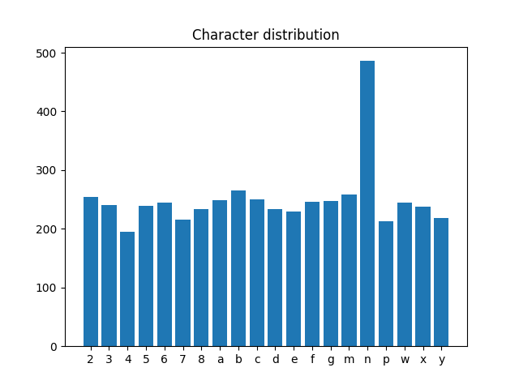


Some Observations
The characters used aren’t all of the characters in the alphabet and all the digits
The letter h doesn’t exist

Slide 7


Quick Cleanup
The border pixels were removed
The gradient was cleaned up
The shorter line was removed

Slide 8








Cleaner isn’t always better
A combination of erosion and median filtering was used to filter out the second longer line
This resulted in a data loss greater than the benefits of the cleaner image
In the end this cleaning step wasn’t used for the final model

Slide 9
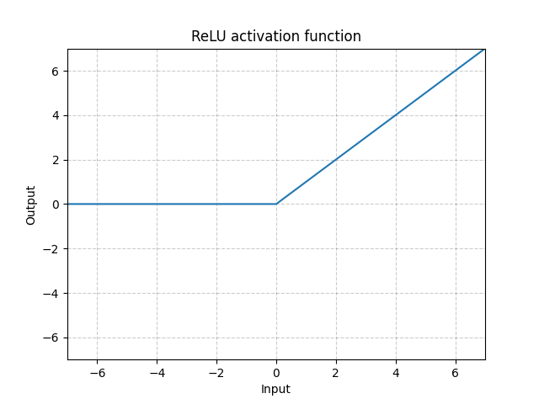
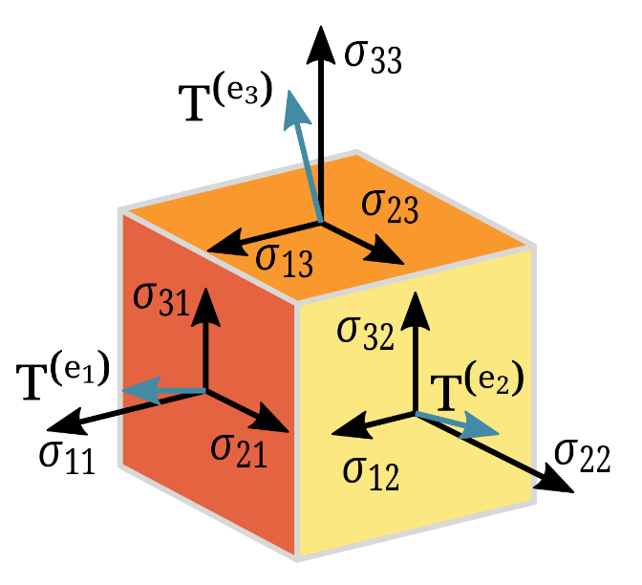
The Convolutional Neural Network
The networks is named by the mathematical operation it performs, convolution.
Just like a basic feed-forward network it consists of 3 parts:
Input Layer
Hidden Layer(s)
Output Layer
Uses the following hidden layers:
Convolutional
Polling
Fully connected
Tensors as inputs

Slide 10
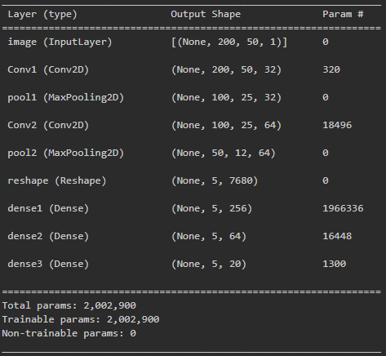
Our CNN

Slide 11
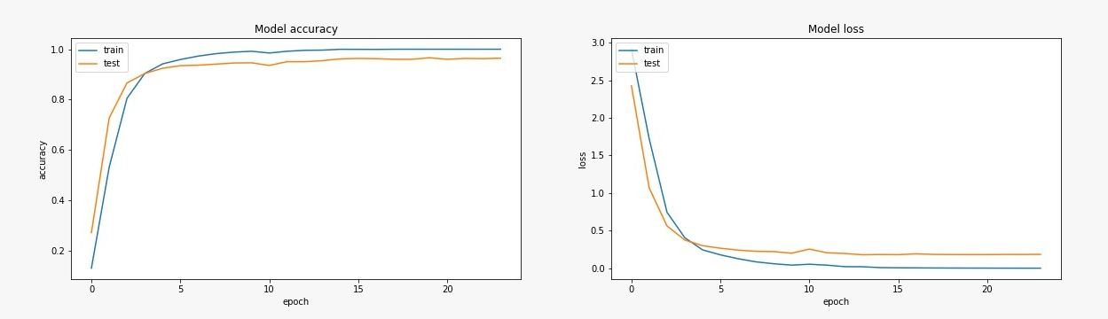
Model Accuracy & Loss Over Time

Slide 12
Demo
Watch and enjoy

Slide 13
Conclusion

Slide 14
Questions?

